Slide 1

NYC Taxis
Jules Pommies
Christopher Tong
Catalina Vanoli

Slide 2
Goals
Airport Rides
Dynamic way to explore data on the browser
Backend DB
Frontend interface
Prediction algorithm for travel time by time

Slide 3
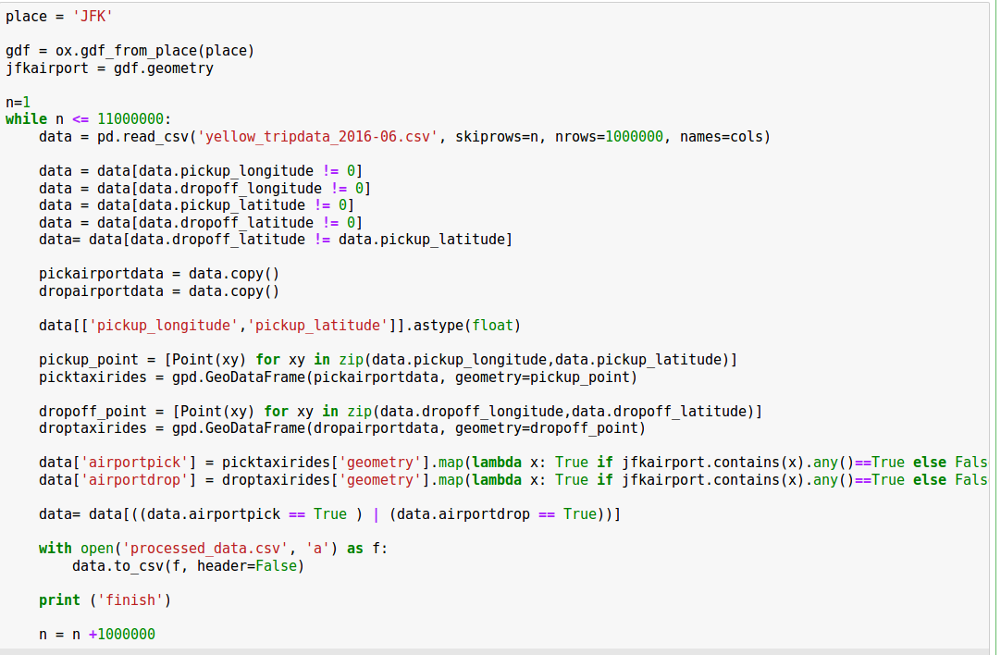
Data Preparation
1 Month → 11 Million rides
Iterative
300 Thousand JFK Airport rides
Spatial query
shapely

Slide 4
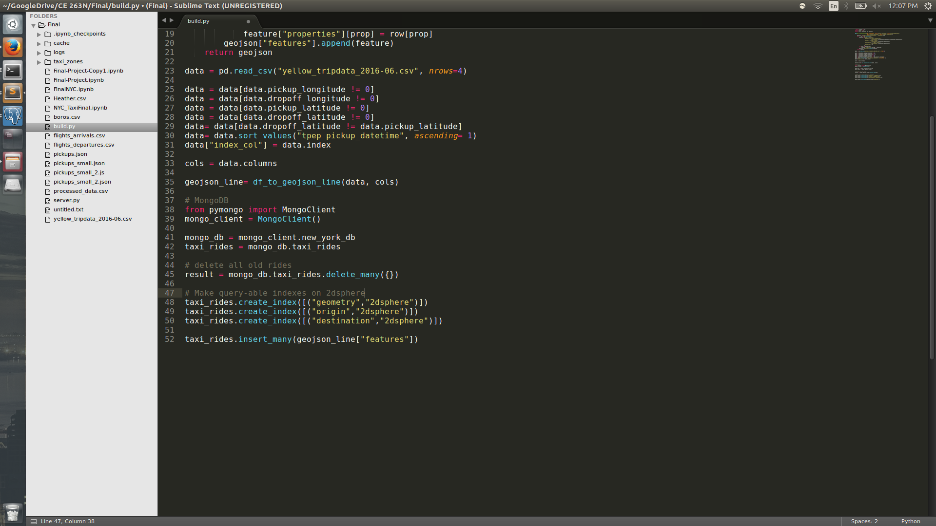
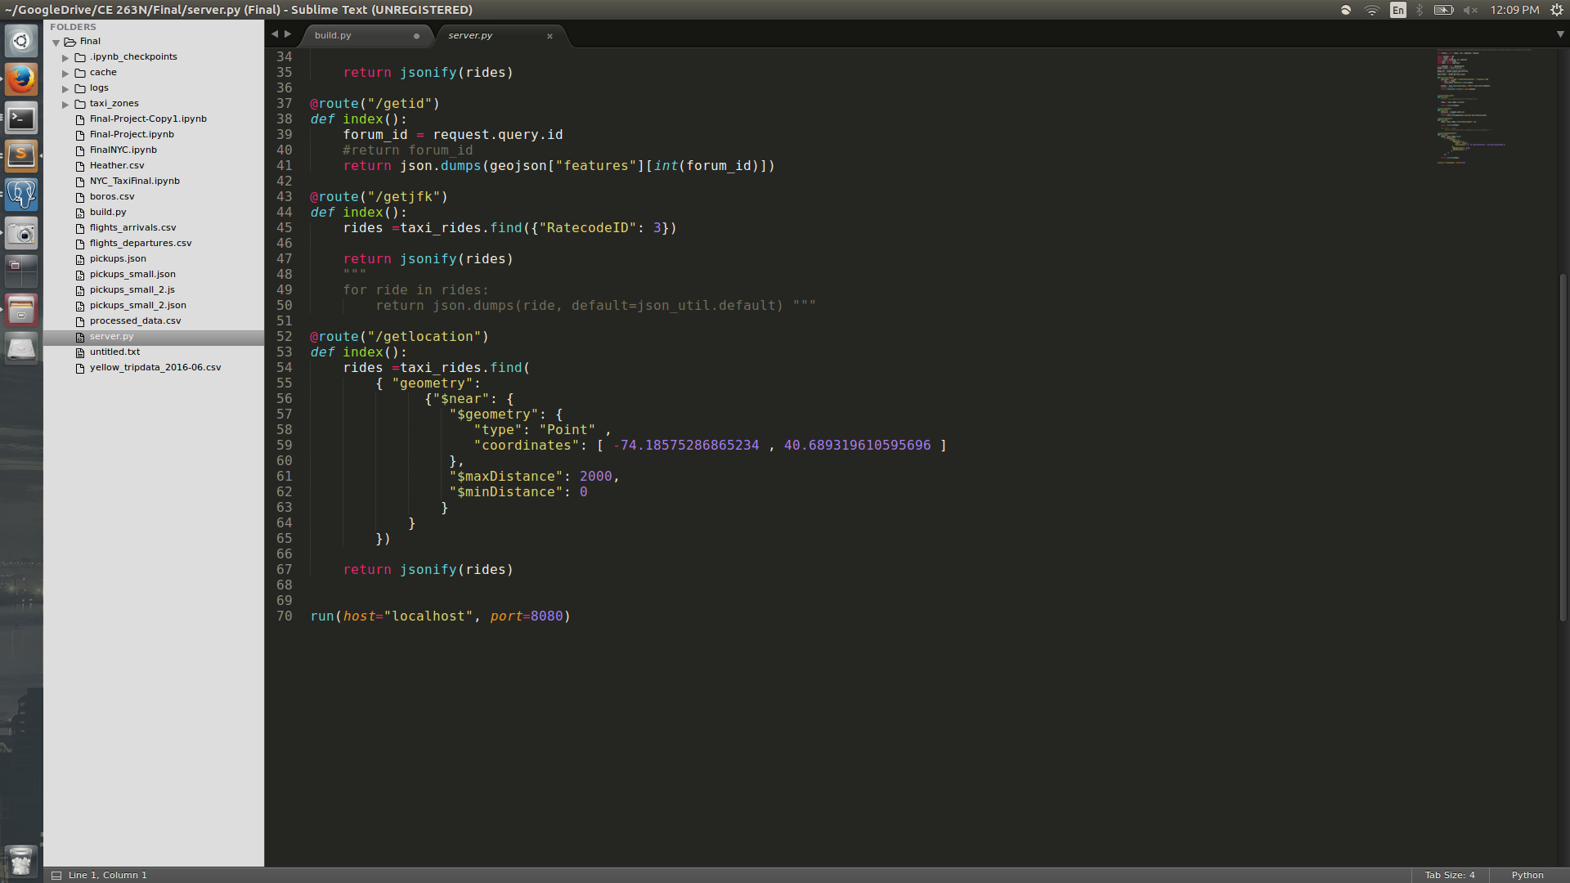
Database
MongoDB server
PostGIS

Slide 5
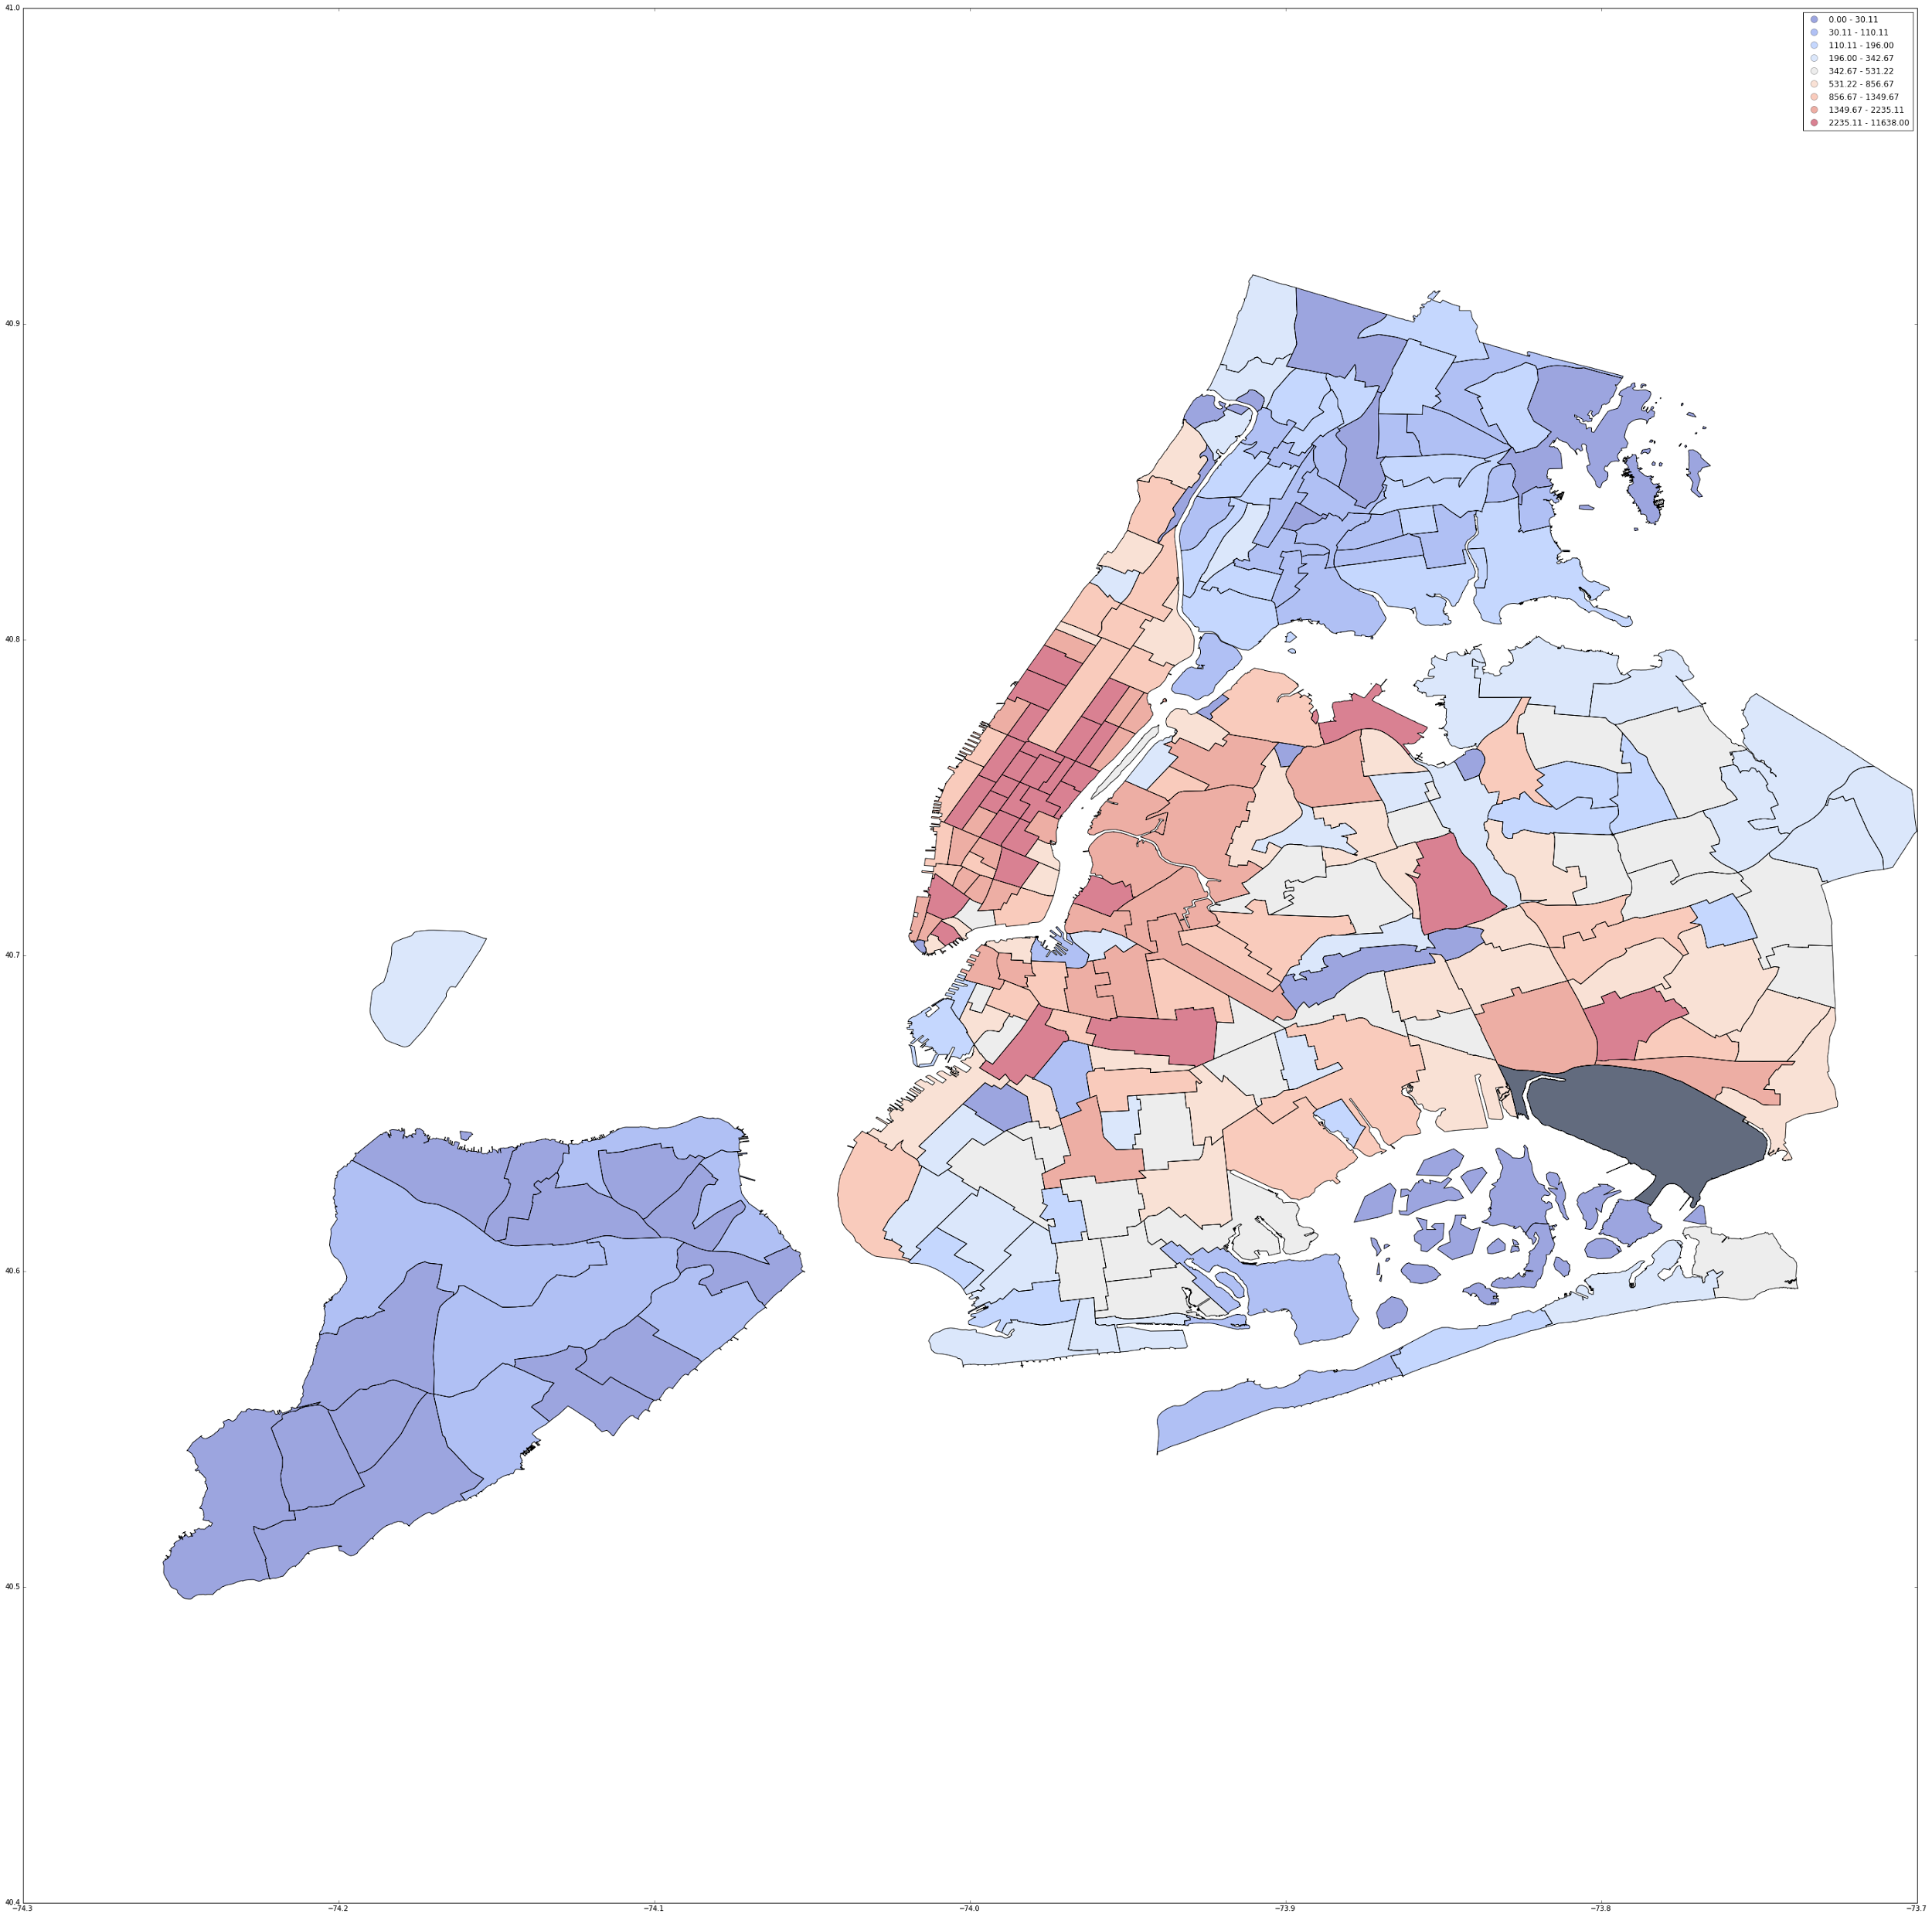
Density from Airport
Number of rides by km
Per taxi zone

Slide 6
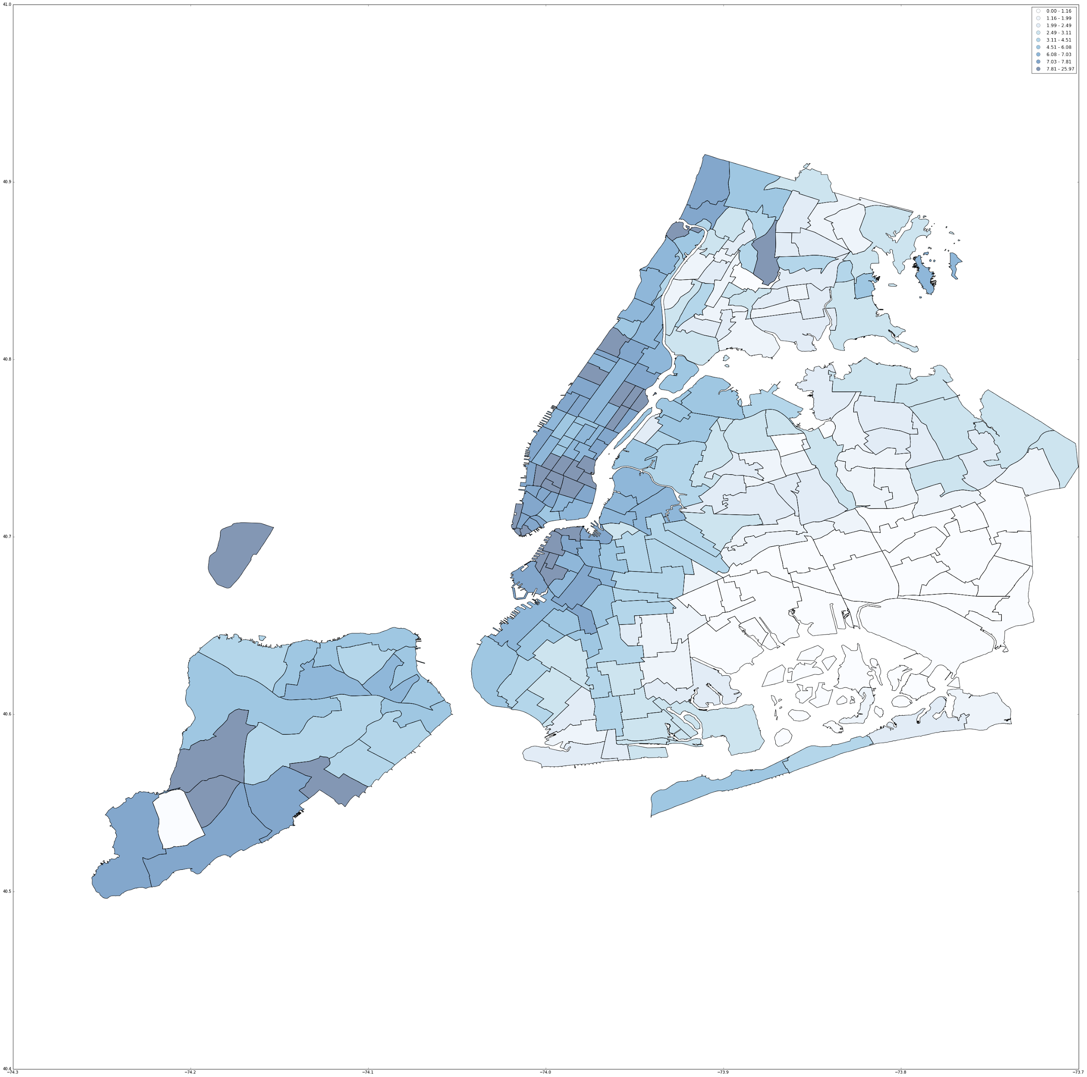
Tips
Mean Tip per zone

Slide 7
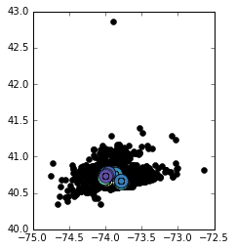
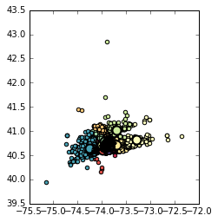
Clustering
DB Scan
Mini Batch Kmeans
Gaussian Process - Travel Time
Prediction

Slide 8
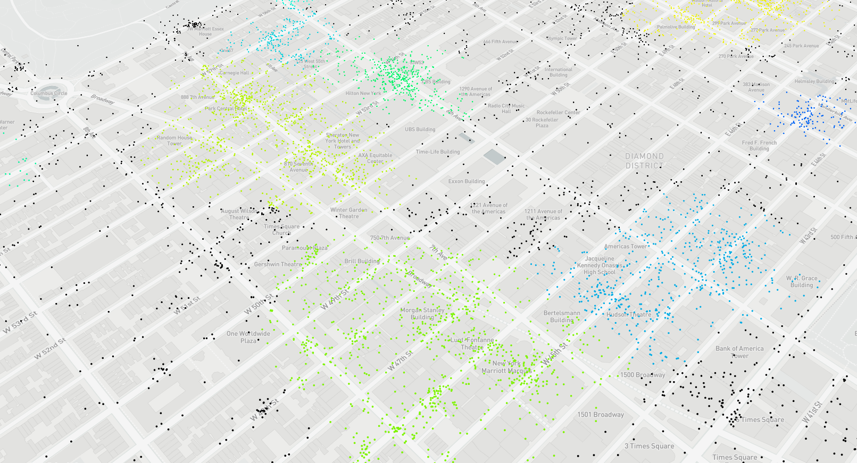
Visualization

Slide 9
Next Steps
To-Airport Clustering
Finish exploratory analysis
Improve flight predictions
Time Series Visualization
Flight arrivals
Network analysis
Optimals free flow routes vs actual travel time
Web app

